Slide 1

Software
It’s what we do

Slide 2

Learn the 3 basic constructs of programming, sis!
Sequence
Iteration
Selection

Slide 3
Machine code
01010101, 00010110, 00110111, 10010010, 00000000, 00110000, 00000001
Properties…
Fast (if it’s written efficiently)
Specific to CPU / CPU family
CISC vs RISC
Complex instruction set
Has * and / (!?)
Reduced instruction set
Instructions take 1 cycle
How were SIS done with machine code?

Slide 4
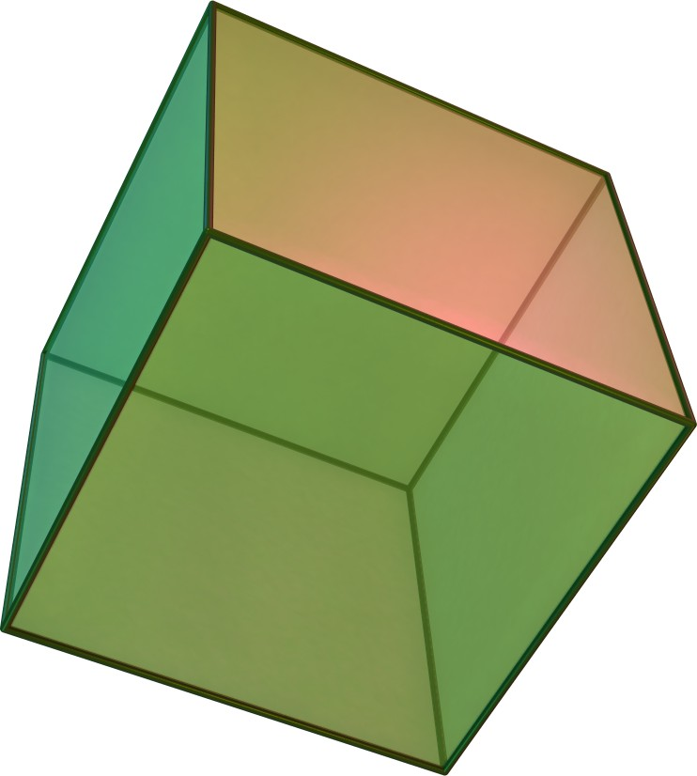
Abstraction

Slide 5
Machine code recap
But we are not a decode unit!
Why should we learn something so unintuitive!
Opcode | Operand what to do | what on | Instruction
0000 0000 | End
0001 address | Add
0010 address | Subtract
0011 address | Store
0101 address | Load
0110 address | Branch
0111 address | Branch if ACC = 0
1000 address | Branch if ACC >= 0
1001 0001 | Input
1001 0010 | Output

Slide 6

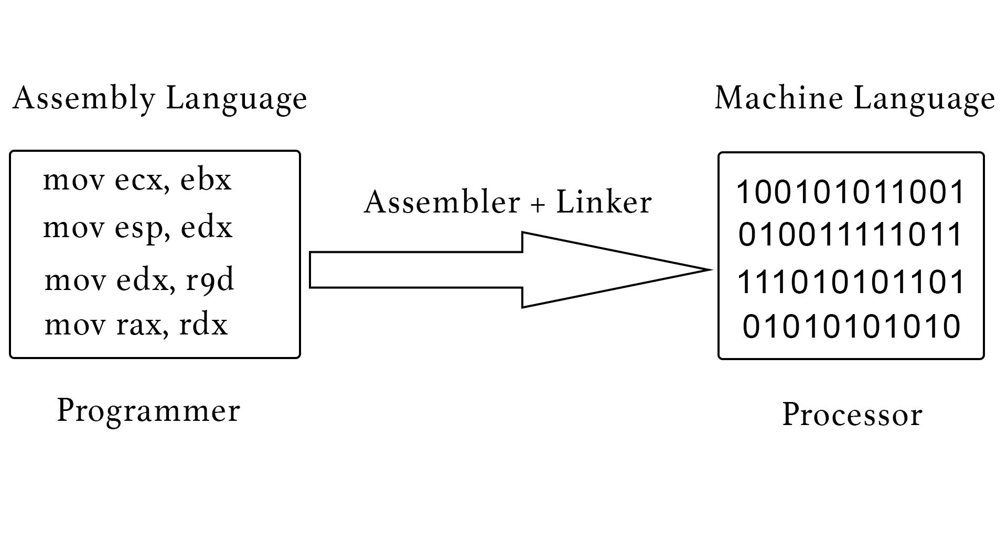
Assembly code
I know, we’ll use words!
Credit to Kathleen Booth, Maurice Wilkes and David Wheeler
Easier for puny humans

Slide 7
Assembly code
Instruction | Mnemonic | Machine Code
Load | LDA | 5xx
Store | STA | 3xx
Add | ADD | 1xx
Subtract | SUB | 2xx
Input | INP | 901
Output | OUT | 902
End | HLT | 000
Branch if zero | BRZ | 7xx
Branch if zero or positive | BRP | 8xx
Branch always | BRA | 6xx
Data storage | DAT

Slide 8

Work out what the programs do
Open LMC
Try to design a program that adds 2 to an input and outputs the answer
Complete the LMC tasks and save your programs to text files
plenary is RISC vs CISC

